Slide 1



Medication Reminder and Compliance System
Baguio, Jamaica P.
Balagot, Maria Suzette I.
Lagare, Lianne
Lim, Sandarah C.
Pulmano, Benjie Jr. A.

Slide 2

INTRODUCTION
The Medication Reminder and Compliance System is, therefore a Java-based application that has been helpful in assisting the people manage their medication effectively. The system will use automated reminders and tracking features to help people stick to their medication schedules, promoting healthier habits and actions for better overall well-being. The system aims at making the medication-taking process simple, reducing the possibilities of missed medication doses, and aids in the proper management of health.

Slide 3
Objectives
Objectives
Enhance Medication Adherence
Simplify Medication Management
Promote Healthy Habits
Provide Comprehensive Tracking Tools
Improve User Experience

Slide 4
Scope and Delimitation
The Medication Reminder and Compliance System is a Java-based application focused on assisting users in managing their medication schedules effectively. The study primarily encompasses:
Key Features:
Automated reminders to notify users about scheduled medications.
Medication tracking to monitor adherence and ensure no doses are missed.
Interfaces such as Home Page, Medication Management, Medical Logging, Adherence Tracking, and Profile for comprehensive health management.
Target Users:
Individuals who need assistance managing their medication schedules.
Patients with chronic illnesses or those undergoing complex treatment plans.

Slide 5
Scope and Delimitation
Technology Used:
Developed using Java Swing for the user interface, ensuring a simple and user-friendly experience.
Database integration to securely store user data, such as medication schedules, adherence logs, and profile information.
Development and Testing:
The study focuses on the design, implementation, and testing of the system, ensuring it meets functional and usability standards.

Slide 6
Scope and Delimitation
The study is limited to the following:
Functionality:
The system is designed for managing medication schedules and adherence tracking only. It does not provide advanced medical advice or diagnosis.
Features such as real-time syncing with wearable devices or integration with external healthcare systems are beyond the current scope.
Target Audience:
The system caters to individual users rather than large-scale healthcare institutions.
It assumes users are familiar with basic mobile or desktop application usage.

Slide 7
Scope and Delimitation
Technical Constraints:
The project is developed using Java Swing, limiting some advanced graphical interface capabilities compared to modern frameworks.
The database integration focuses on local or basic cloud storage rather than enterprise-grade solutions.
Geographic and Resource Limitations:
Testing and feedback are based on a limited sample size, primarily within the university or community of the development team.
Access to healthcare professionals for validation of the system's functionality is minimal.

Slide 8
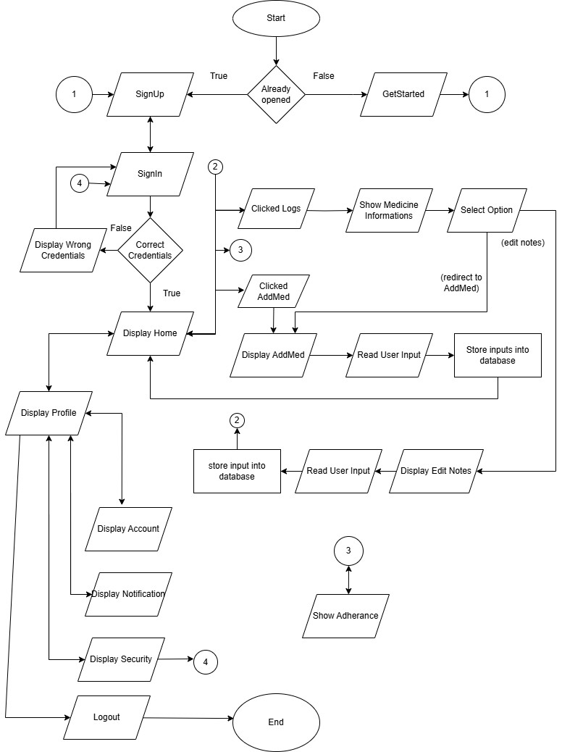
FLOWCHART
Start and Initialization:
The process starts with the system checking if the app is already opened:
If True, the user is redirected to the SignUp page.
If False, the user selects GetStarted, which leads to the SignUp process.
Sign Up and Sign In:
After SignUp, the user proceeds to the SignIn flow:
If the user enters the wrong credentials, a Display Wrong Credentials page is shown.
If correct credentials, the user is redirected to the Display Home screen.

Slide 9
FLOWCHART
Main Application Option (Home):
From the Display Home page, the user can access various features:
Clicked Logs:
Leads to a page displaying Medicine Information.
Provides options to edit notes or redirect to the AddMed feature.
Clicked AddMed:
Opens the Display AddMed page, where the user can input medicine information.
User input is stored in the database.
Show Adherence:
Displays the adherence tracking progress.

Slide 10
FLOWCHART
Profile and Account Navigation:
From the Display Home page, the user can navigate to:
Display Profile, which links to:
Display Account: Allows viewing or modifying account details.
Display Notification: review alerts or reminders.
Display Security: Manage security settings like change new password from the user.
Logout:
Users can log out at any point, which ends the session.

Slide 11
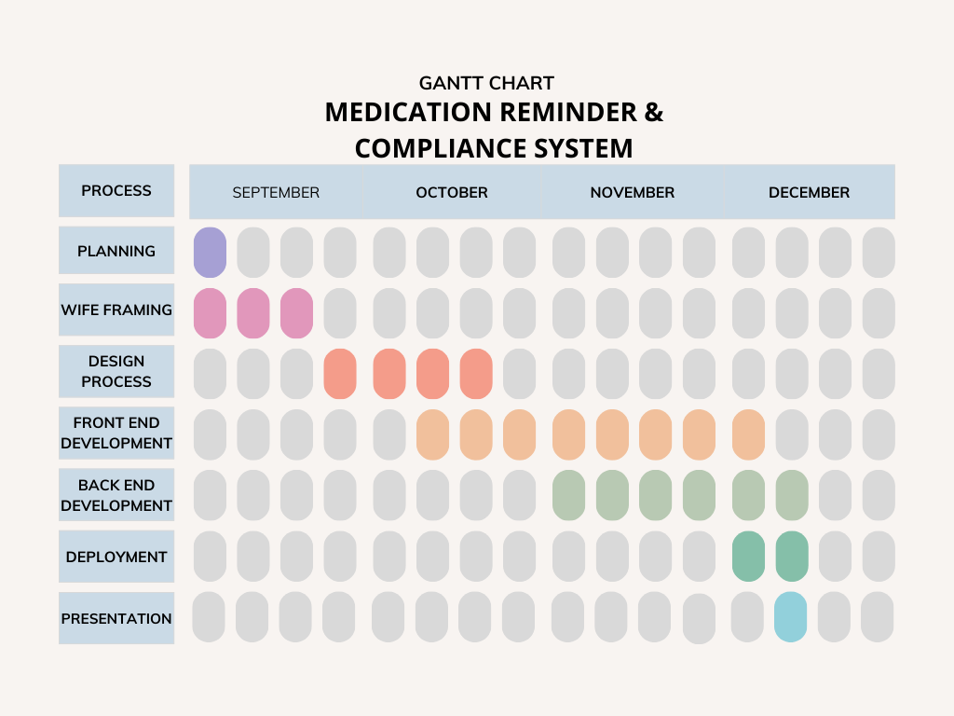
GANTT CHART

Slide 12
GANTT CHART
Planning (Purple):
Focused on the initial groundwork and strategy, completed in September.
Wireframing (Pink):
Conducted alongside planning, focusing on the structural design of the system, also completed in September.
Design Process (Orange):
The visual and functional design development phase, carried out throughout October.
Front-End Development (Light Orange):
Implementing the user interface, initiated in October up to the 1 week of December.
Back-End Development (Green):
Setting up the system’s core functionality, conducted from November to mid-December.

Slide 13
GANTT CHART
Deployment (Teal):
Launching the system, scheduled for completion towards the 2nd week of December.
Presentation (Light Blue):
Final presentation or demonstration of the system, planned for the last phase in December.

Slide 14
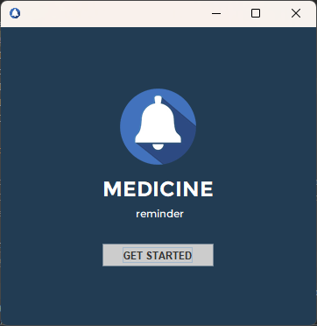
SYSTEM DESIGN
WELCOME INTERFACE
Description
The welcome interface of the Medication Reminder and Compliance System features a modern and user-friendly design. It prominently displays a bell icon, symbolizing reminders, alongside the title "Medicine" and the subtitle "reminder." The calming dark blue background enhances readability and conveys professionalism. A clear "GET STARTED" button invites users to begin their journey with the app, ensuring an intuitive and accessible experience for all users. This interface sets a welcoming tone, emphasizing the system's focus on supporting medication adherence.

Slide 15
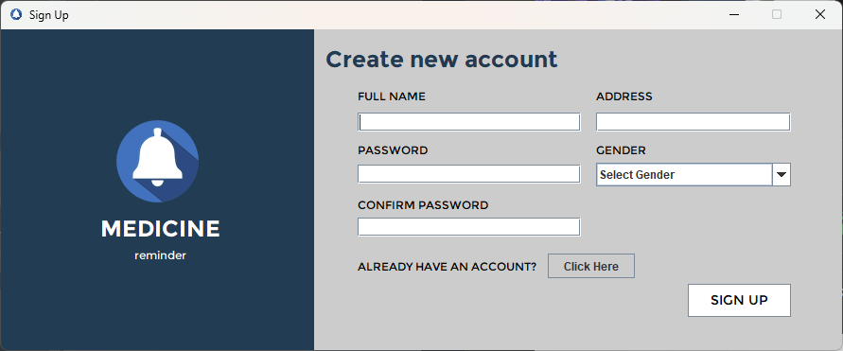
SYSTEM DESIGN
SIGN UP INTERFACE
Description:
The screen allows existing users to sign in to their account by entering their credentials. This interface is designed to authenticate existing users in a simple and intuitive manner. The minimal design ensures users can quickly identify their actions—whether signing in or creating a new account if they don't already have one.

Slide 16
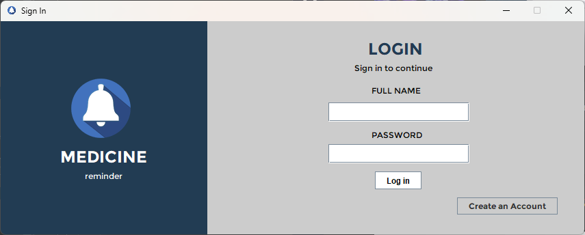
SYSTEM DESIGN
LOG IN INTERFACE
Description:
The screen allows existing users to sign in to their account by entering their credentials. This interface is designed to authenticate existing users in a simple and intuitive manner. The minimal design ensures users can quickly identify their actions—whether signing in or creating a new account if they don't already have one.

Slide 17
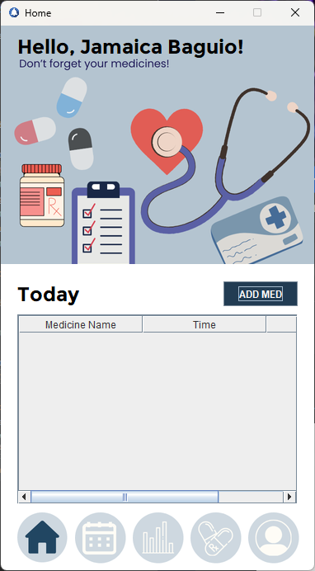
SYSTEM DESIGN
HOME PAGE INTERFACE
Description:
This interface makes it easy for users to stay on top of their daily medications. You can add your meds, set reminders for when to take them. There's a handy section that shows your schedule for the day, so you know exactly what's coming up. Plus, with a home button to quickly return to the main screen, everything is designed to be straightforward and simple to use.

Slide 18
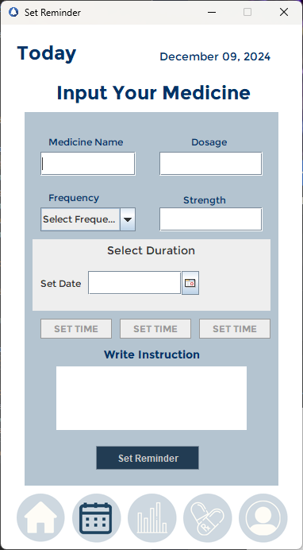
SYSTEM DESIGN
MEDICATION MANAGEMENT INTERFACE
Description:
The interface is designed to help users keep track of their medicine schedule. It allows users to add medicines, and set reminders

Slide 19
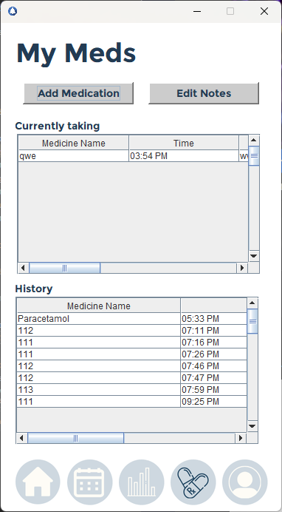
SYSTEM DESIGN
MEDICAL LOGGING INTERFACE
Description:
This section plays a vital role in ensuring users can stay organized, track their medications in real time, and reflect on their history for better adherence and health outcomes.

Slide 20
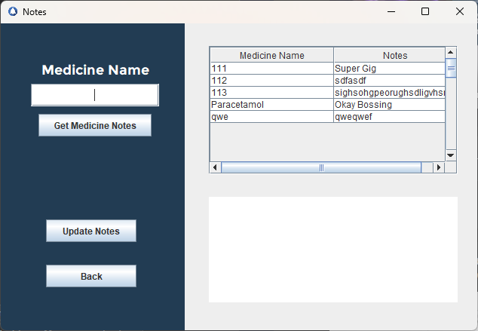
SYSTEM DESIGN
Medicine Notes Management Interface
Description:
The Medicine Notes Management Module is a critical component of the medication reminder system. It provides users with an interface to search, view, and update notes related to medicines, ensuring streamlined information access and medication adherence.

Slide 21
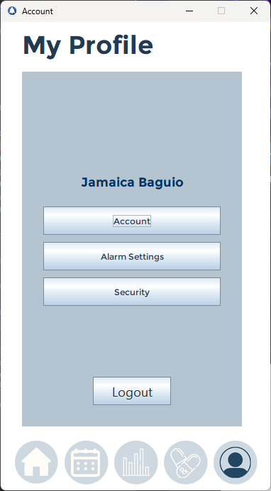
SYSTEM DESIGN
MY PROFILE INTERFACE
Description:
This profile section of the app allows users to easily manage their personal information. It includes options to update their name, alarm setting, and change password from the security button. This user- friendly design helps users keep their profile up to date with just a few taps. There's also a navigation bar at the bottom for quick access to other sections like the home page, set reminder, adherence tracker, and viewing medication details.

Slide 22
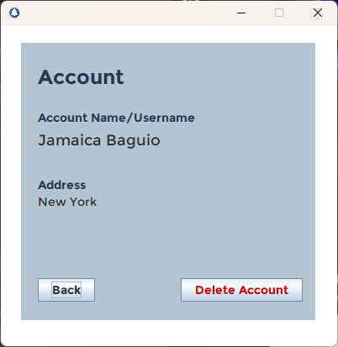
SYSTEM DESIGN
Account Management Interface
Description:
This interface is designed to display account information and provide users with options to navigate or manage their account. It ensures that users have access to essential account details and can perform critical actions like account deletion.

Slide 23
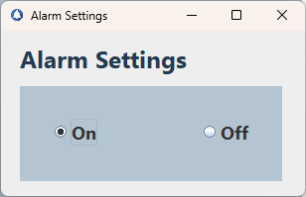
SYSTEM DESIGN
ALARM INTERFACE
Description:
This interface is to allow the user to control the state of an alarm system.

Slide 24
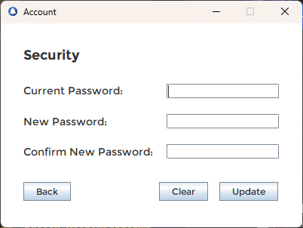
SYSTEM DESIGN
Password Management Interface
Description:
This interface is designed to enhance account security by allowing users to update their passwords. It ensures that password changes are done securely and intuitively while minimizing the risk of errors.

Slide 25
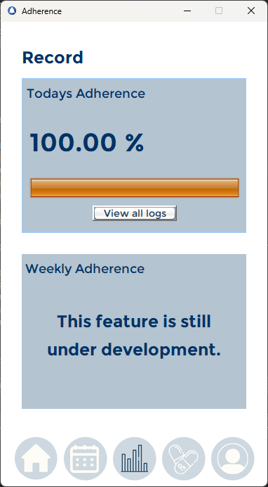
SYSTEM DESIGN
ADHERENCE TRACKING INTERFACE
Description:
This section is crucial for promoting accountability and building user habits for regular medication intake. It supports the system's primary goal of improving medication adherence by offering real-time feedback, transparency, and easy access to related features. While the weekly adherence still under development, the features presented lay the groundwork for a robust adherence-tracking module that can integrate daily and weekly progress for enhanced user engagement.

Slide 26
CONCLUSION
The Medication Reminder and Compliance System is a Java-based application designed to help users manage their medication effectively. It has successfully implemented core features like login, sign-up, and a user-friendly interface with home, set reminder, adherence tracker, medication logs, and the account button. The application delivers a comprehensive solution for personal health management. The use of Java Swing for the interface ensures a smooth and intuitive user experience, while the database integration guarantees secure and efficient storage of user information.
The Medication Reminder and Compliance System successfully achieves its goal of helping users manage their medication schedules efficiently and consistently. By providing automated reminders, a user-friendly interface, and robust medication tracking tools, the system significantly reduces the likelihood of missed doses and promotes better adherence to prescribed treatments.
Overall, the system has proven to be an effective tool for individuals managing their medication routines. It addresses the common challenges of medication adherence by simplifying processes and providing consistent support, thereby contributing to healthier lifestyles for its users.

Slide 27
RECOMMENDATION
To further improve the Medication Reminder and Compliance System, it is recommended to enhance its functionality by integrating advanced features such as customizable notifications, medication refill alerts, and weekly and monthly adherence tracker . Expanding to mobile platforms and adding multilingual and accessibility options can significantly improve user experience and reach a wider audience. Security measures like data encryption, cloud backup, and compliance with privacy regulations should be prioritized to ensure user trust. Additionally, collaborating with healthcare providers and incorporating user feedback will help refine the system, making it a more reliable and impactful tool for medication management.

